Slide 1
ARTIFICIAL INTELLIGENCE AND MACHINE LEARNING UNIT - 1
Shreya J Shetty
Assistant Professor Gd-I
MCA Department
NMAMIT,Nitte

Slide 2
What is Artificial Intelligence?
Artificial Intelligence (AI) is a way of making a computer, a computer-controlled robot, or software think intelligently, similar to the way intelligent humans think.
AI is accomplished by studying how the human brain thinks and how humans learn, decide, work, and solve problems.
The outcomes of this study are used as the basis for developing intelligent software and systems.
The term Artificial Intelligence was first coined in 1956 by John McCarthy at the Dartmouth Conference.
John McCarthy defined AI as "the science and engineering of making intelligent machines."

Slide 3
Many AI applications are not recognized as AI because people often think AI refers only to robots performing daily chores.
In reality, AI has become a part of our everyday lives.
AI has become so common that we often use it without realizing it.
Google Search uses AI to provide accurate search results.
Facebook uses AI to display content based on users' interests and preferences.
These are common examples of the application of Artificial Intelligence.

Slide 4
Philosophy of Artificial Intelligence (AI)
While exploring the power of computer systems, humans became curious and asked, "Can a machine think and behave like humans?"
This curiosity led to the development of Artificial Intelligence (AI).
The main goal of AI is to create machines that can exhibit intelligence similar to that of humans.
AI aims to develop systems that can think, learn, reason, and make decisions like humans.
The philosophy of AI is based on understanding and replicating human intelligence in machines.
It focuses on creating intelligent machines capable of performing tasks that normally require human intelligence.

Slide 5
Why Artificial Intelligence?
AI helps in developing software and devices that can solve real-world problems accurately and efficiently.
AI is used to address problems in various fields such as healthcare, marketing, transportation, and traffic management.
AI enables the creation of virtual assistants such as Cortana, Google Assistant, and Siri.
AI is used to build intelligent robots that can work in dangerous environments where human survival is at risk.
Examples of AI-powered robots include Spirit, Curiosity, and Vikram.
AI improves automation, accuracy, and decision-making in various applications.
AI opens the way for the development of new technologies, innovative devices, and future opportunities.
Learning AI helps in building smart systems capable of performing tasks that normally require human intelligence.

Slide 6
Goals of AI
To Create Expert Systems
The systems which exhibit intelligent behavior, learn, demonstrate, explain, and advice its users.
To Implement Human Intelligence in Machines
Creating systems that understand, think, learn, and behave like humans.

Slide 7
What Contributes to Artificial Intelligence (AI)?
AI is based on the following disciplines:
Computer Science – Develops algorithms, software, and intelligent systems.
Biology – Studies the human brain and nervous system to inspire AI models.
Psychology – Helps AI understand human thinking, learning, and behavior.
Linguistics – Enables machines to understand and process human language.
Mathematics – Provides the foundation for algorithms, logic, probability, and machine learning.
Engineering – Designs and builds AI-based machines, robots, and hardware systems.

Slide 8
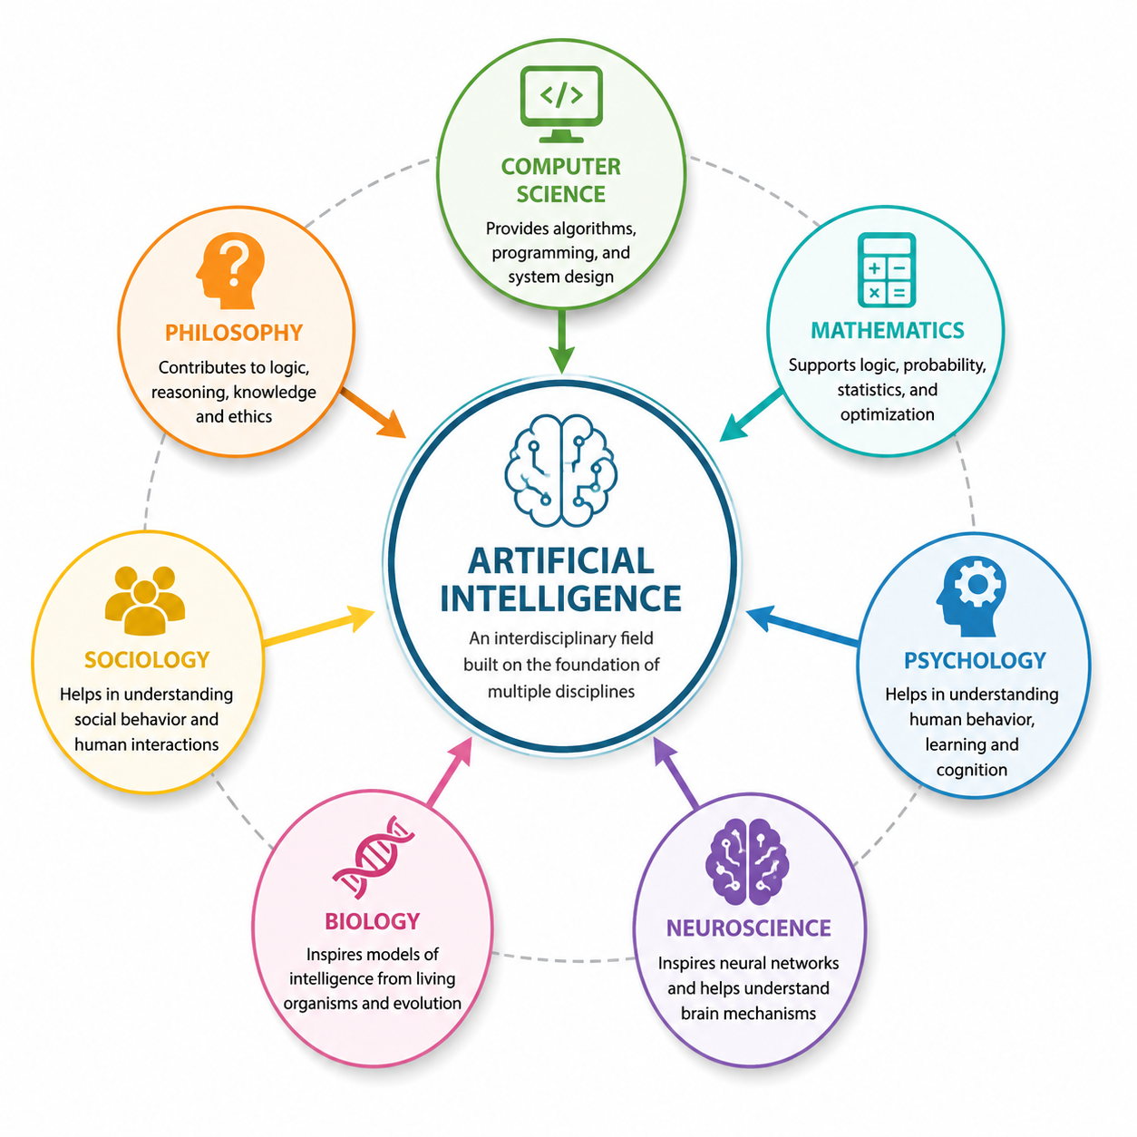

Slide 9
Major Thrust of AI
AI mainly focuses on developing computer functions associated with human intelligence, such as:
Reasoning – Making logical decisions based on available information.
Learning – Acquiring knowledge from data and improving performance over time.
Problem Solving – Finding effective solutions to complex problems.

Slide 10
Advantages of Artificial Intelligence
High Accuracy with Fewer Errors - AI systems perform tasks with high precision and reduce human errors by making decisions based on data and experience.
High Speed - AI processes large amounts of data quickly and makes faster decisions than humans.
High Reliability - AI can perform repetitive tasks consistently with the same level of accuracy without getting tired.
Useful in Risky Situations - AI can work in hazardous environments such as bomb disposal, deep-sea exploration, mining, and space missions, reducing risks to humans.
Digital Assistant - AI powers virtual assistants like Siri, Google Assistant, and Alexa, helping users with daily tasks and personalized recommendations.
Useful in Public Services - AI improves public services through applications such as self-driving cars, facial recognition for security, traffic management, and natural language processing for human-computer communication.

Slide 11
Disadvantages of Artificial Intelligence
High Cost
Developing and maintaining AI systems requires expensive hardware, software, and skilled professionals.
Can't think out of the box:
Even though we are making smarter machines with AI, but still they cannot work out of the box, as the robot will only do that work for which they are trained, or programmed.
Lack of Emotions
AI has no feelings, emotions, or empathy, so it cannot build emotional relationships or understand human emotions.
Increased Dependency on Machines
Excessive use of AI may make people more dependent on technology and reduce their critical thinking and problem-solving skills.
No Original Creativity
AI can generate content based on existing data but cannot create truly original ideas or use imagination like humans.

Slide 12
Applications of Artificial Intelligence
Artificial Intelligence has various applications in today's society. It is becoming
essential for today's time because it can solve complex problems with an efficient
way in multiple industries, such as Healthcare, entertainment, finance, education,
etc. AI is making our daily life more comfortable and fast.
Following are some sectors which have the application of Artificial Intelligence:
Gaming − AI plays crucial role in strategic games such as chess, poker, tic-tac-toe, etc., where machine can think of large number of possible positions based on heuristic knowledge.

Slide 13
Natural Language Processing (NLP)
It is possible to interact with the computer that understands natural language spoken by humans.
Expert Systems
There are some applications which integrate machine, software, and special information to impart reasoning and advising. They provide explanation and advice to the users.
Vision Systems
These systems understand, interpret, and comprehend visual input on the computer.
Examples:
A spying aeroplane takes photographs, which are used to figure out spatial information or map of the areas.
Doctors use clinical expert system to diagnose the patient.
Police use computer software that can recognize the face of criminal with the stored portrait made by forensic artist.

Slide 14
Speech Recognition
Some intelligent systems are capable of hearing and comprehending the language in terms of sentences and their meanings while a human talks to it. It can handle different accents, slang words, noise in the background, and changes in a human's voice due to cold, etc.
Handwriting Recognition
The handwriting recognition software reads the text written on paper by a pen or on screen by a stylus. It can recognize the shapes of the letters and convert them into editable text.
Intelligent Robots
Robots are able to perform the tasks given by a human. They have sensors to detect physical data from the real world such as light, heat, temperature, movement, sound, bump, and pressure. They have efficient processors, multiple sensors, and huge memory to exhibit intelligence. In addition, they are capable of learning from their mistakes and can adapt to new environments.

Slide 15
AI in Astronomy
Solves complex problems related to the universe.
Helps understand the origin and working of the universe.
Detects and identifies distant planets in solar systems.
Can spot planets that are about 2500 light-years away.

Slide 16
AI in Healthcare
Improves healthcare by providing faster and more accurate diagnosis.
Assists doctors in diagnosing diseases and recommending treatments.
Monitors patients and alerts doctors when a patient's condition worsens.
Example: Apple Watch monitors health conditions.
IBM Watson is used by over 230 healthcare organizations worldwide for medical diagnosis.
In 2016, IBM Watson correctly diagnosed a rare leukemia case by analyzing 20 million oncology records.
Google's AI Eye Doctor analyzes retinal scans to detect diabetic retinopathy, a disease that can cause blindness.

Slide 17
Google Predictive Search
One of the most popular applications of AI.
Suggests search queries as the user types.
Uses AI to predict what the user is searching for.
Recommendations are based on user data such as location, age, and search history.
Helps users find information quickly and accurately.
Virtual Assistants
AI-powered assistants such as Siri, Alexa, and Cortana.
Understand and respond to voice commands.
Help users perform tasks like setting reminders, answering questions, and controlling smart devices.
Google Duplex can make phone calls and book appointments with a human-like conversation style.

Slide 18
AI in Finance
AI automates financial processes and improves efficiency.
Used in automation, chatbots, adaptive intelligence, algorithmic trading, and machine learning.
Helps analyze financial and legal documents quickly.
JP Morgan's COiN (Contract Intelligence) Platform uses AI, machine learning, and image recognition to analyze legal documents.
AI extracts important data points and clauses within seconds.
Reviewing 12,000 agreements manually takes over 36,000 hours, whereas AI completes the task in seconds.

Slide 19
AI in Data Security
AI improves the security of data and protects against cyber threats.
Detects software bugs and cyber-attacks quickly.
Enhances data safety through intelligent threat detection.
Examples: AEG Bot and AI2 Platform.
AI in Social Media
AI manages and organizes billions of user profiles efficiently.
Analyzes large amounts of data to identify trends, hashtags, and user preferences.
Facebook uses AI for face verification and automatic photo tagging.
Twitter (X) uses AI, machine learning, deep learning, and NLP to detect hate speech and terrorist content.
AI helped identify and ban over 300,000 terrorist-linked accounts, with 95% detected automatically by AI.

Slide 20
AI in Travel & Transport
AI is widely used in the travel and transport industry.
Helps in booking trips, suggesting hotels, flights, and the best travel routes.
AI-powered chatbots provide quick and human-like customer support.
Improves customer experience through personalized travel recommendations.
AI in Automotive Industry
AI provides intelligent virtual assistants in modern vehicles.
Tesla uses TeslaBot as an intelligent virtual assistant.
AI is used to develop self-driving (autonomous) cars.
Self-driving cars use computer vision, image detection, and deep learning to detect objects and drive without human intervention.
Tesla's Autopilot and RoboTaxi are examples of AI-powered autonomous driving systems.

Slide 21
AI in Robotics
AI enables robots to perform tasks intelligently using learning and experience.
Unlike traditional robots, AI robots are not limited to pre-programmed instructions.
AI-powered robots can adapt to new situations and improve their performance.
Examples: Sophia and Erica are humanoid robots that can talk and interact like humans.
AI in Entertainment
AI is widely used in entertainment platforms such as Netflix and Amazon Prime.
Machine Learning (ML) and AI recommend movies, TV shows, and other content based on user preferences.
Provides personalized recommendations to improve the user experience.
AI in Agriculture
AI is transforming agriculture by making farming more efficient.
Used in agricultural robotics, soil monitoring, crop monitoring, and predictive analysis.
Helps farmers improve productivity and crop yield.
Reduces the need for labor, time, and resources while increasing efficiency.

Slide 22
AI in E-commerce: AI is providing a competitive edge to the e-commerce
industry, and it is becoming more demanding in the e-commerce business.
AI is helping shoppers to discover associated products with recommended size, color, or even brand.
AI in education: AI can automate grading so that the tutor can have more
time to teach. AI chatbot can communicate with students as a teaching assistant.
AI in the future can be work as a personal virtual tutor for students, which will be accessible easily at any time and any place.
Literature: composing poems

Slide 23
Common Misconceptions: AI, Machine Learning, and Deep Learning
People often think that Artificial Intelligence (AI), Machine Learning (ML), and Deep Learning (DL) are the same because they are used together in many applications (e.g., Siri). However, they are different but related technologies.
Artificial Intelligence (AI)
AI is the science of making machines mimic human intelligence and behavior.
It is the broadest field.
Machine Learning (ML)
ML is a subset of AI.
It enables machines to learn from data and make decisions without being explicitly programmed.
Deep Learning (DL)
DL is a subset of Machine Learning.
It uses artificial neural networks to solve complex problems.

Slide 24
Relationship
Artificial Intelligence ⊃ Machine Learning ⊃ Deep Learning
ML and DL help AI solve data-driven problems.
AI is not limited to ML and DL; it also includes many other fields.
Other Fields of AI
Natural Language Processing (NLP)
Object Detection
Computer Vision
Robotics
Expert Systems

Slide 25
Types of Artificial Intelligence
Artificial Intelligence can be divided in various types, there are mainly two types of main categorization which are based on capabilities and based on functionally of AI.
Following is flow diagram which explain the types of AI.

Slide 26
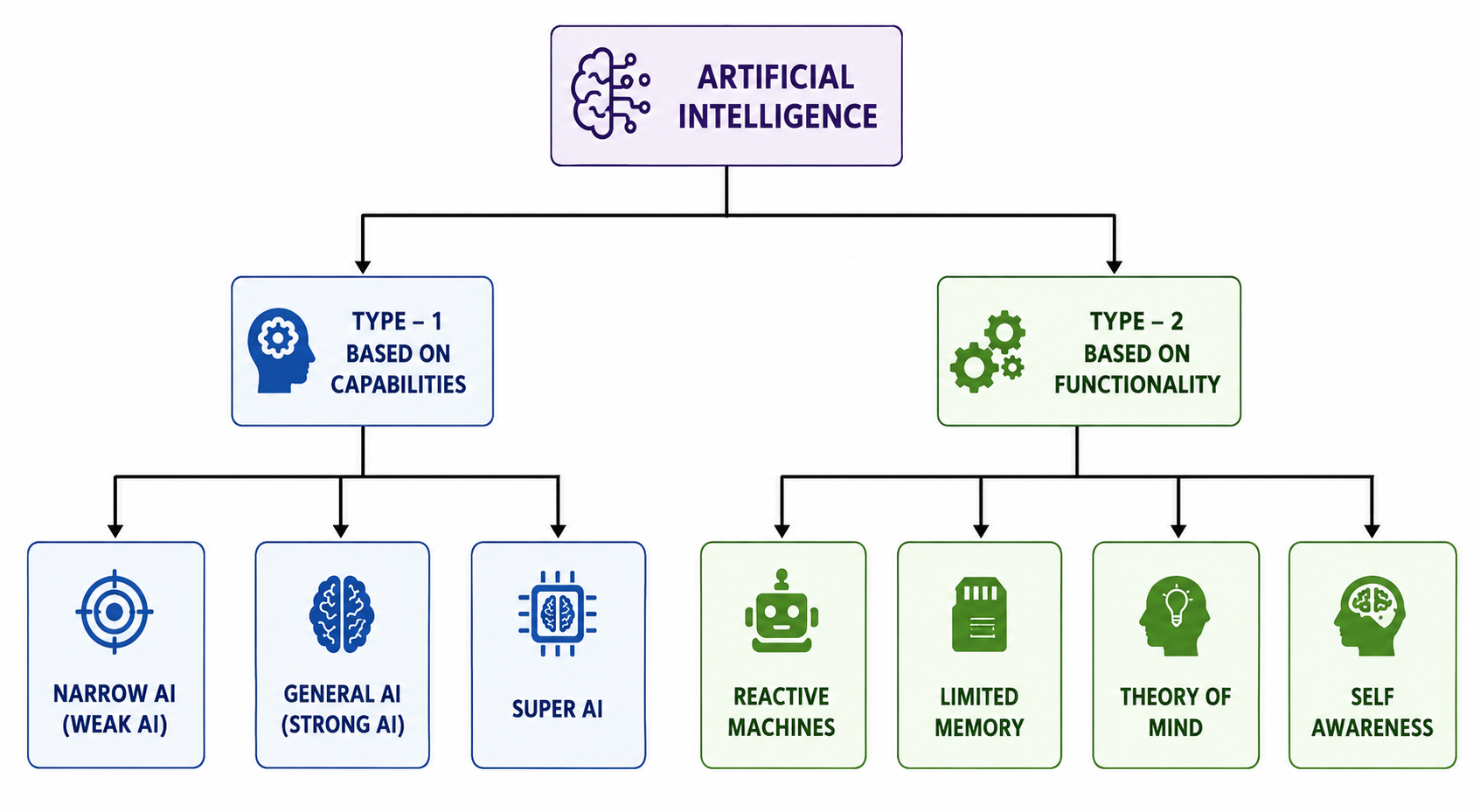

Slide 27
AI type-1: Based on Capabilities 1. Weak AI or Narrow AI:
Narrow AI is a type of AI which is able to perform a dedicated task with
intelligence. The most common and currently available AI is Narrow AI in
the world of Artificial Intelligence.
Narrow AI cannot perform beyond its field or limitations, as it is only
trained for one specific task. Hence it is also termed as weak AI. Narrow AI
can fail in unpredictable ways if it goes beyond its limits.
Apple Siri is a good example of Narrow AI, but it operates with a limited
pre-defined range of functions.

Slide 28
IBM's Watson supercomputer also comes under Narrow AI, as it uses an
Expert system approach combined with Machine learning and natural
language processing.
Some Examples of Narrow AI are playing chess, purchasing suggestions on
e-commerce site, self-driving cars, speech recognition, and image
recognition.

Slide 29
2. General AI:
General AI is a type of intelligence which could perform any intellectual
task with efficiency like a human.
The idea behind the general AI to make such a system which could be
smarter and think like a human by its own.
Currently, there is no such system exist which could come under general AI and can perform any task as perfect as a human.
The worldwide researchers are now focused on developing machines with
General AI.
As systems with general AI are still under research, and it will take lots of
efforts and time to develop such systems.

Slide 30
3. Super AI:
Super AI is a level of Intelligence of Systems at which machines could surpass human intelligence, and can perform any task better than human with cognitive properties. It is an outcome of general AI.
Some key characteristics of strong AI include capability include the ability to think, to reason, solve the puzzle, make judgments, plan, learn, and communicate by its own.
Super AI is still a hypothetical concept of Artificial Intelligence.Development of such systems in real is still world changing task.
Narrow AI – Dedicated for one task
General AI – Performs like human
Super AI – Intelligent than human

Slide 31
Artificial Intelligence type-2: Based on functionality 1. Reactive Machines
Purely reactive machines are the most basic types of Artificial Intelligence.
Such AI systems do not store memories or past experiences for future actions.
These machines only focus on current scenarios and react on it as per possible best action.
IBM's Deep Blue system is an example of reactive machines.
Google's AlphaGo is also an example of reactive machines.

Slide 32
2. Limited Memory
Limited memory machines can store past experiences or some data for a short period of time.
These machines can use stored data for a limited time period only.
Self-driving cars are one of the best examples of Limited Memory systems.
These cars can store recent speed of nearby cars, the distance of other cars,speed limit, and other information to navigate the road.

Slide 33
3. Theory of Mind
Theory of Mind AI should understand the human emotions, people, beliefs, and be able to interact socially like humans.
This type of AI machines are still not developed, but researchers are making lots of efforts and improvement for developing such AI machines.

Slide 34
4. Self-Awareness
Self-awareness AI is the future of Artificial Intelligence. These machines will be super intelligent, and will have their own consciousness, sentiments, and self-awareness.
These machines will be smarter than human mind.
Self-Awareness AI does not exist in reality still and it is a hypothetical concept.
Since the emergence of AI in the 1950s, we have seen an exponential growth in its
potential. AI cover domains such as machine learning, deep learning, neural
networks, natural language processing, knowledge base, expert systems, and so on.
It has also made its way into computer vision and image processing.

Slide 35
What is State Space?
State Space Search is used to solve problems by finding different possible states and their transitions. In simple terms it’s like finding the best route to goal by trying different paths.
It works by systematically checking possible states until the goal is reached.
This method can be applied to various AI tasks such as pathfinding, puzzle solving, game playing and more.
State space = All possible situations/states of a problem.
Eg ; 8-Puzzle
Each configuration is a state.

Slide 36
It works by systematically checking each state and moving to new states until the goal is reached. It consider the problem as a series of steps and it moves from one state to another until the goal is reached.
This method can be applied to various AI tasks such as pathfinding, puzzle solving, game playing and more.
The core idea behind state space search is to think of the problem as a graph where:
Nodes represent different states of the problem.
Edges represent transitions or actions that change one state into another.

Slide 37
Terminologies consist of:
State: A specific configuration of the problem.
Initial State: Starting point of the search.
Goal State: Desired end configuration.
Transition: An action that changes one state to another.
Path: A sequence of states connected by transitions.
Search Strategy: Method used to explore the state space.

Slide 38
Features of State Space Search
Branching Factor: Average number of successors per state. A higher branching factor makes search tree wider which increases time and resources required.
Depth: Number of steps from the initial state to the goal state. Deeper trees increase the search time as more states must be explored.
Completeness: A search is complete if it guarantees finding a solution if one exists. It ensures the algorithm will eventually reach the goal.
Optimality: A search is optimal if it guarantees finding the best solution, according to a specific criterion liked least cost or shortest path.
Time and Space Complexity: Measure the time and memory required for the search, both of which increase with the branching factor and search depth.

Slide 39
Steps in State Space Search
Step 1: Define the State Space First, identify all the possible states of the problem and the actions/transitions between them.
A state represents a particular situation or configuration.
A transition represents an action that changes one state into another.
Example: In the 8-puzzle problem, each arrangement of the tiles is a state.

Slide 40
Step 2: Pick a Search Strategy
After defining the state space, choose a method to search for the goal state.
1. Uninformed Search
Uninformed search does not use additional information about how close a state is to the goal.
Breadth-First Search (BFS): Explores all nodes at the current depth before moving to the next depth. It can find the shortest path when all step costs are equal.
Depth-First Search (DFS): Goes as deep as possible along one branch before backtracking. It generally uses less memory but may not find the shortest solution.
Uniform Cost Search (UCS): Expands the node with the lowest path cost first. It can find the lowest-cost solution when costs are non-negative.

Slide 41
2. Informed Search
Informed search uses heuristic information to decide which states are more promising.
Greedy Best-First Search: Selects the node that appears closest to the goal according to a heuristic.
A* Search: Uses both the cost already travelled and the estimated cost to the goal.
The evaluation function is:
f(n) = g(n) + h(n)
where:
g(n) = actual cost from the start state to node n
h(n) = estimated cost from node n to the goal
Admissible Heuristic: A heuristic is admissible if it never overestimates the actual cost to reach the goal. A* is optimal when an admissible heuristic is used under the usual conditions.

Slide 42
Step 3: Start the Search and Extend the Nodes
Start from the initial state and apply the selected search strategy.
The algorithm:
Selects a node from the frontier.
Expands the node.
Generates its successor states.
Adds the successors to the frontier.
Checks whether a goal state has been reached.
If the goal is found, the algorithm can trace back the path to obtain the solution.

Slide 43
Step 4: Address State Repetition
The same state may be reached through different paths. To avoid unnecessary work and infinite loops, the algorithm keeps track of visited states.
This helps to:
Avoid cycles.
Prevent repeated exploration.
Reduce unnecessary computation.
Example: If state A leads to B and B leads back to A, the algorithm should not continue visiting A repeatedly.

Slide 44
Step 5: End the Search
The search terminates in either of two situations:
Goal state is found: The solution path is returned.
No solution is found: All possible states have been explored without reaching the goal.

Slide 45
Applications
Pathfinding: Finding the best pathways using algorithms such as A* in robotics and GPS.
Puzzle solving: Resolving puzzles like Rubik's Cube, Sudoku and the 8-puzzle.
AI for gaming: To identify good moves in board games like chess, checkers and others.
Planning: Automated scheduling of tasks in logistics and robotics to achieve a specific objective.
Natural language processing: It involves computer translation and sentence parsing by examining many interpretations.

Slide 46
Challenges
Complexity: High branching factors can cause an exponential growth in the number of states to be explored.
Resource Limitations: Memory and processing power limit size of the state space that can be practically searched.
Quality of Heuristics: The effectiveness of the search is limited by the quality of the heuristic function.

